Slide 1
Welcome to
Math & Logic!

Slide 2
Review: What did we do in class last time?
Preview: What day of the week will it be
753 + 1413 days from today?
Notes:
Review: Modular Arithmetic
Preview: Same question as what day of the week will it be 4 + -1 days from today. 753 is congruent to 4 mod 7; 1413 is congruent to -1 mod 7.

Slide 3
Number Systems
Competency: Apply Numbers Systems to Problem Solving
Modular Arithmetic
Addition
Subtraction

Slide 4
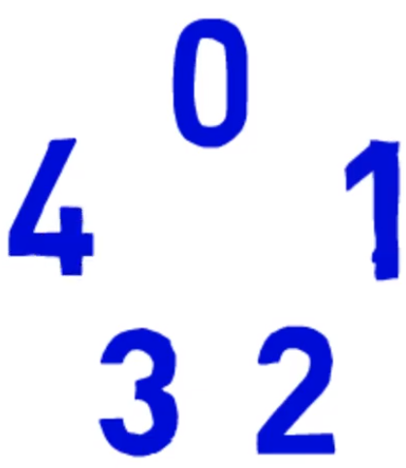
Modulo Addition
Mod 5
Notes:
1 mod 5 = -4 mod 5
-2 mod 5 = 3 mod 5

Slide 5
Modulo Addition
MOD 5 Addition | 0 | 1 | 2 | 3 | 4
0
1
2
3
4
Notes:
“Anything” mod 5 can only result in 0, 1, 2, 3, or 4

Slide 6
Modulo Addition
The additive inverses in mod 5 are:
1 & 4 and 2 & 3
Recall that additive inverses are two numbers that you add together to get to 0.
Notes:
(1 + 4) mod 5 = 0
(2 + 3) mod 5 = 0

Slide 7
Modulo Addition
2 mod 5
7 mod 5
12 mod 5
17 mod 5
22 mod 5

Slide 8
Modulo Addition
2 mod 5
7 mod 5 (2+5) mod 5
12 mod 5 (2+10) mod 5
17 mod 5 (2+15) mod 5
22 mod 5 (2+20) mod 5

Slide 9
Modulo Addition
Let’s Practice!
Notes:
Practice: Modulo Add & Subtract: 1-4

Slide 10
Modulo Subtraction
The additive inverses in mod 5 are:
1 & 4 and 2 & 3
Notes:
1 mod 5 = -4 mod 5 = 1 Going forward 1 puts you in the same place as going backward 4. Adding 1 is like subtracting 4.
-2 mod 5 = 3 mod 5 = 3 Going backward 2 puts you in the same place as going forward 3. Subtracting 2 is like adding 3.

Slide 11
Modulo Subtraction
6 mod 5
1 mod 5
-4 mod 5
-9 mod 5
-14 mod 5

Slide 12
Modulo Subtraction
6 mod 5
1 mod 5 (6-5) mod 5
-4 mod 5 (6-10) mod 5
-9 mod 5 (6-15) mod 5
-14 mod 5 (6-20) mod 5

Slide 13
Modulo Subtraction
Let’s practice now!
Notes:
Practice: Modulo Add & Subtract: 5-20

Slide 14
Review
Modular Arithmetic
Addition
Subtraction

Slide 15
To Do:
SmartEvals tab in Canvas
Modulo Operator Quiz
Modulo Add & Subtract Quiz
Number Systems Assignment
Crash Course 31
Crash Course 32
Crash Course 33

Slide 16
Have a great day!
And remember that every day
at CVTC is a great day!

